Slide 1
Control techniques and Information technology
Session 40

Slide 2
Budget as a control device
Budgeting: The formulation of plans for a given future period in numerical terms.

Slide 3
Dangers in budgeting
Inaccuracy
Rigid decision making
Time required
Gaming the system
Blame for outcomes
Expense allocations
Use it or lose it
Only considers financial outcomes

Slide 4
Zero based budgeting
Zero-based budgeting (ZBB) is a method of budgeting in which all expenses must be justified for each new period. The process of zero-based budgeting starts from a "zero base," and every function within an organization is analyzed for its needs and costs.

Slide 5
Traditional non-budgetary Control devices and Time-event network analysis

Slide 6
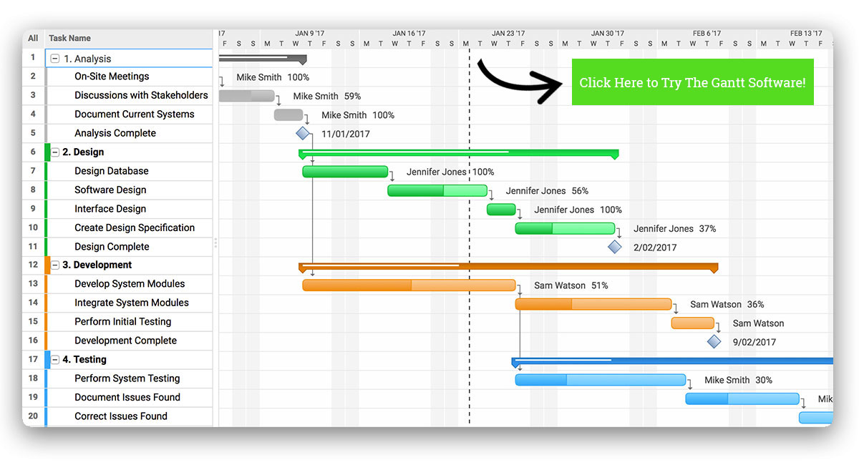
Gantt chart

Slide 7
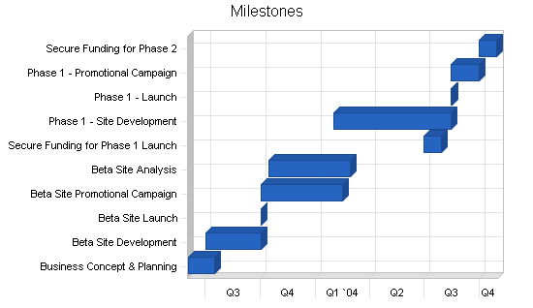
Milestone budgeting

Slide 8
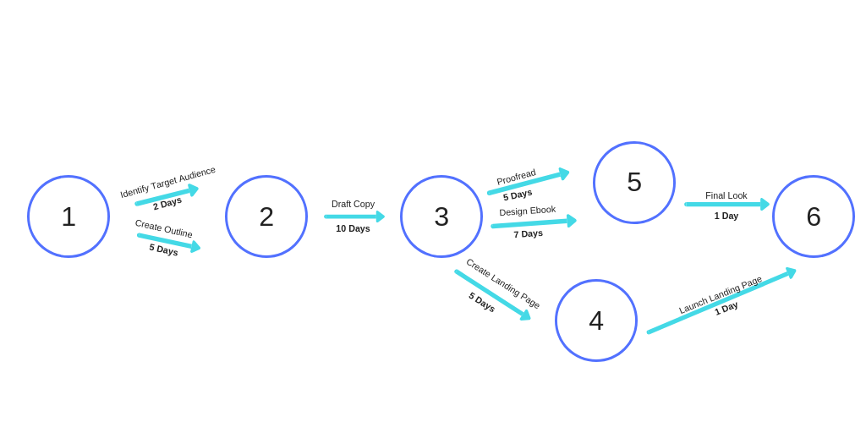
PERT Chart

Slide 9
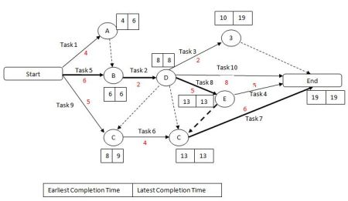
CPM(Critical Path Method)

Slide 10
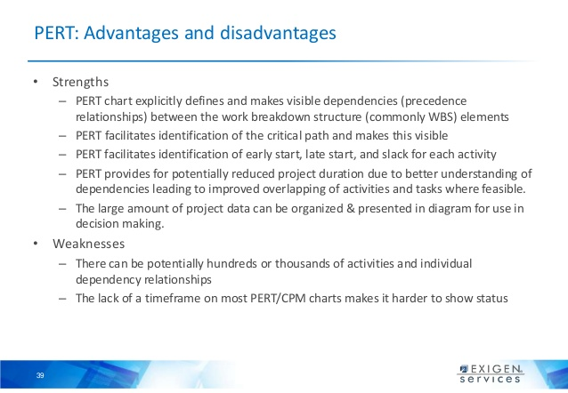
Strengths and Weaknesses of PERT

Slide 11
Management information system(MIS)
MIS is the use of information technology, people, and business processes to record, store and process data to produce information that decision makers can use to make day to day decisions.

Slide 12
Opportunities and Challenges created by Information Technology
Analytics in Managing
Speech recognition devices
Telecommuting
Computer Networks
The Internet

Slide 13
Other types of networks
Groupware
Freeware
Information security

Slide 14
Digital economy, E-Commerce and M-Commerce

Slide 15
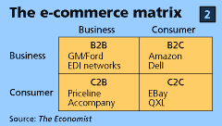
E-Commerce

Slide 16

M-Commerce

Slide 17
Customer relationship Management(CRM)
Customer relationship management is an approach to manage a company's interaction with current and potential customers. It uses data analysis about customers' history with a company to improve business relationships with customers, specifically focusing on customer retention and ultimately driving sales growth.

